Slide 1
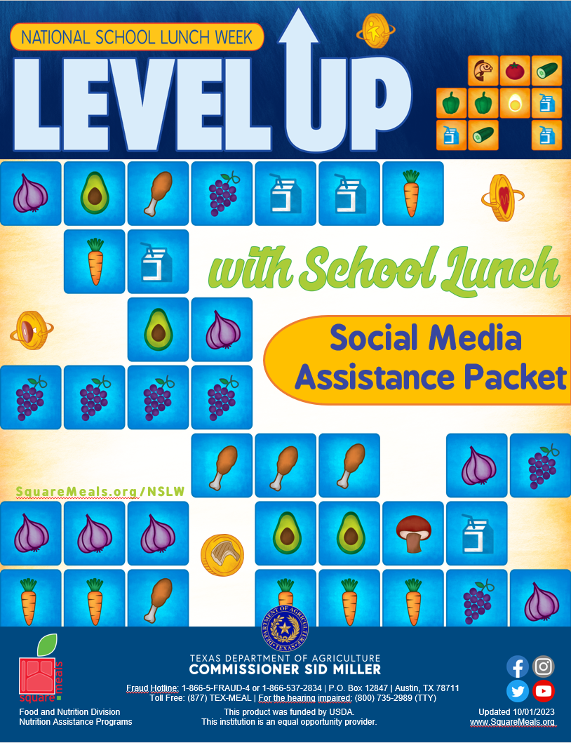

Slide 2
National School Lunch Week Social Media Assistance Packet
This Social Media Assistance Packet provides social media posts (images and text) you can use to increase student engagement through the Texas Department of Agriculture’s (TDA’s) National School Lunch Week (NSLW). Implementing the best practices below and utilizing the copy-and-paste posts and images in this packet will help your school encourage students to take an interest in healthy school meals! All posts can easily be modified for your school.
Social Media Best Practices
Developing your social media strategy in advance can eliminate stress and ensure consistent messaging. Keep these best practices in mind when planning social media content, whether it’s for your school website, Facebook, Twitter or Instagram.
Your Audience includes parents, kids, local media, and community leaders. Language and content should be tailored to reach the appropriate audience. Always keep the reader in mind as you write. Every message should be easy for your audience to read.
Use Photos, Videos or GIFs to add visual appeal and capture additional attention. Use the images provided or add your own.
Facebook Video, Facebook Live and Instagram’s Boomerang offer ways to add interactive elements to communication platforms and further engage your audience.
A Social Media Tag creates a short link to a profile and the post may be added to that person’s or group’s timeline. This will increase the visibility of the posts beyond an immediate audience. This can help reach media and local officials. It also helps extend your posts’ longevity.
Consider tagging local news outlets and writers, radio stations, and your local mayor.
Tag TDA on Facebook and Twitter
Twitter: @TexasDeptofAg
Facebook: TexasDepartmentofAgriculture
Hashtags: #NSLW23 #TXNSLW #NSLWBiteSeenAcrossTexas
Fraud Hotline: 1-866-5-FRAUD-4 or 1-866-537-2834 | P.O. Box 12847 | Austin, TX 78711
Toll Free: (877) TEX-MEAL | For the hearing impaired: (800) 735-2989 (TTY)
Food and Nutrition Division
School Breakfast Week
This product was funded by USDA.
This institution is an equal opportunity provider.
Updated 7/7/2023
www.SquareMeals.org

Slide 3
Copy-and-Paste
Images and Posts
POST #1
National School Lunch Week is two weeks away! Join us in recognizing the importance of a healthy lunch. Visit www.SquareMeals.org/NSLW for more information. #TXNSLW #NSLW23
POST #2
Parents and Guardians, please join us next week and “Level Up with School Lunch” during National School Lunch Week, October 9-13! Learn more at www.SquareMeals.org/NSLW #TXNSLW #NSLW23
POST #3
Today kicks off National School Lunch Week! Join us all week as students “Level Up with School Lunch”! #TXNSLW #NSLW23
Fraud Hotline: 1-866-5-FRAUD-4 or 1-866-537-2834 | P.O. Box 12847 | Austin, TX 78711
Toll Free: (877) TEX-MEAL | For the hearing impaired: (800) 735-2989 (TTY)
Food and Nutrition Division
School Breakfast Week
This product was funded by USDA.
This institution is an equal opportunity provider.
Updated 7/7/2023
www.SquareMeals.org

Slide 4
Copy-and-Paste
Images and Posts
POST #4
Check out how students can “Level Up with School Lunch” by participating in a taste testing event! Students will have the option of trying a “Beta Bake” for National School Lunch Week! #TXNSLW #NSLWBiteSeenAroundTX
POST #5
Encourage your students to eat lunch at school October 9-13 to “Level Up with School Lunch”! Check out our celebration menu and learn more about NSLW at www.SquareMeals.org/NSLW #TXNSLW #NSLW23
POST #6
Calling all parents! Learn how you and your student can level up during school lunch this month! Visit www.SquareMeals.org/NSLW to learn about National School Lunch Week 2023. #TXNSLW #NSLW23
Fraud Hotline: 1-866-5-FRAUD-4 or 1-866-537-2834 | P.O. Box 12847 | Austin, TX 78711
Toll Free: (877) TEX-MEAL | For the hearing impaired: (800) 735-2989 (TTY)
Food and Nutrition Division
School Breakfast Week
This product was funded by USDA.
This institution is an equal opportunity provider.
Updated 7/7/2023
www.SquareMeals.org

